Slide 1

Adidas Sales Analysis
By Handoko Sugiarto
Data Source: Kaggle.com

Slide 2
Total Sales Revenue and Unit Sold 2020-2021
Growth Rate = 294% in Sales Revenue and 77% in Sales Unit

Slide 3
Total Monthly Revenue Per Year

Slide 4
Total Monthly Unit Sold Per Year

Slide 5
Total Sales Revenue by Year and Quarter

Slide 6
Total Unit Sold by Year and Quarter

Slide 7
Total Sales Revenue and Operating Profit by Year
2020 vs 2021
Sales Revenue: Increase by 394%
Operating Profit: Increase by 424%

Slide 8
Total Operating Profit Margin Per Year

Slide 9
Total Unit Sold, Revenue and Profit Margin 2020-2021

Slide 10
Total Sales Revenue Forecast By Quarter

Slide 11
Sales Revenue vs Operating Profit

Slide 12
Sales Unit vs Unit Price
Demand is Elastic Since Elasticity > 1

Slide 13
Average Price Trends Per Year
The Average price trends showed upward trend correlated due to increased in sales revenue for products above price $47 in 2021.

Slide 14
Group Price per Unit Contribution

Slide 15
Price Distribution Analysis
Consumers prefer to spend in the price range of S41-$50, with the following preferences in the order: $31-$40, and $51-$60.

Slide 16
Total Revenue and Average Price by Region Per Year

Slide 17
Total Sales and Average Price by Sales Method Per Year

Slide 18
Retailers Sales Value Share and Average Price Per Year

Slide 19
Retailers Average Sales Value per Transaction

Slide 20
Retailers Sales Value by Year

Slide 21
Product Market Share

Slide 22
Sales Value and Operating Margin by Product Per Year

Slide 23
Total Sales Vs Avg Transaction Contribution by Gender

Slide 24
Sales Value by State Per Year

Slide 25
2021 Sales Value vs Average Sales Value by State

Slide 26
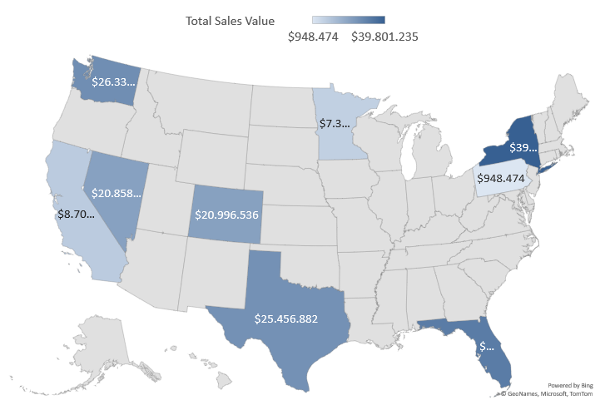
2020 Distribution by Total Sales Value by State
Grey/ no color means no sales in each States

Slide 27

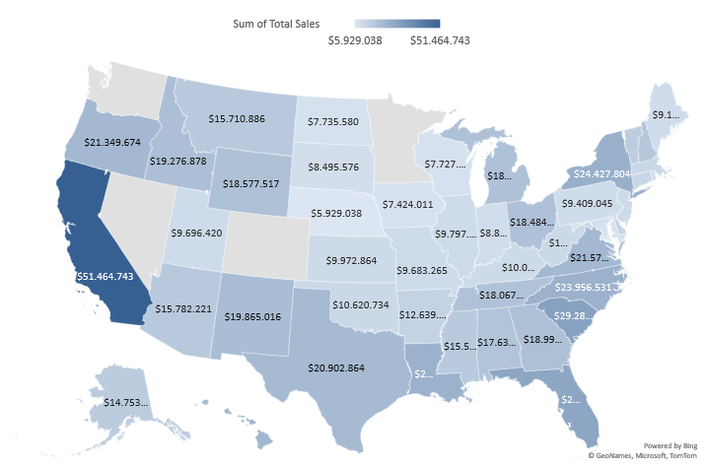
2021 Distribution by Total Sales Value by State
Grey/No color means No Sales. 4 States are without sales: Nevada, Washington, Colorado and Minnesota

Slide 28
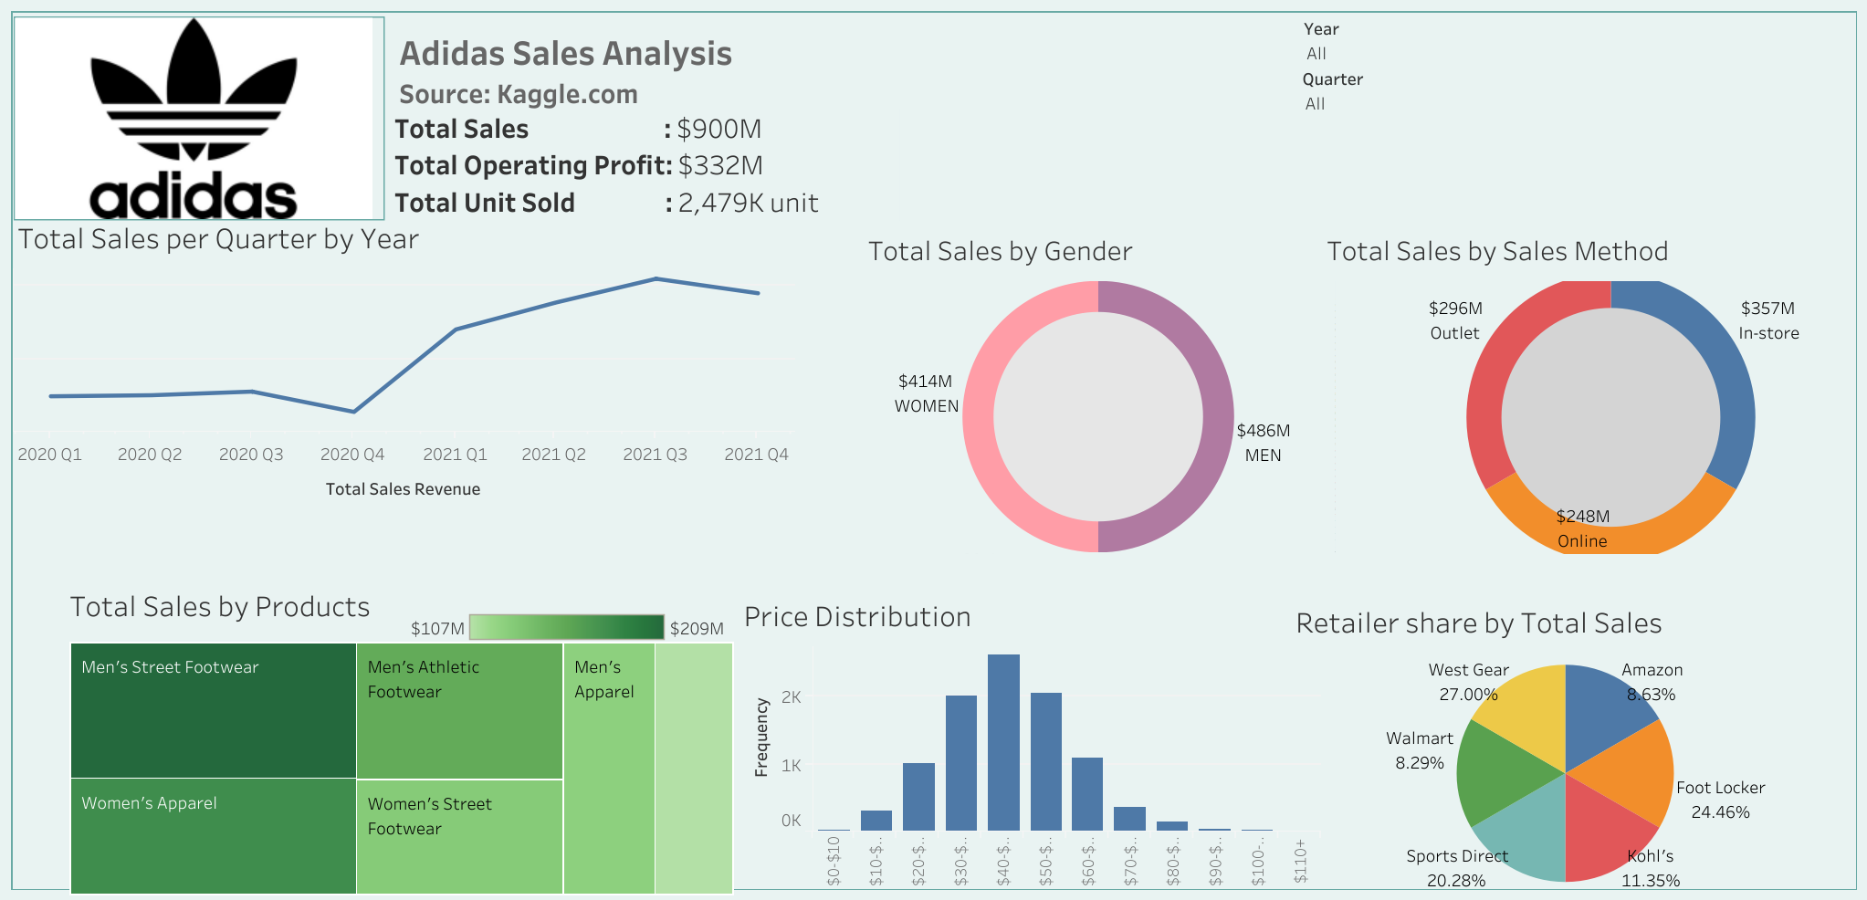
Adidas Sales Analysis Dashboard

Slide 29
Summary
Overall : Adidas sales unit and Revenue have shown recovery correlated with Covid19 pandemic Situation in 2021. The total sales value increased by 394% with the growth rate 294% in 2021. Operating Profit also increase by 424% in 2021.
Business Insight:
1. Based of retailer analysis, I find that 2 retailers have an
average sales value per transaction less than total average
sales value per transaction. Adidas should take action and
make improvement and optimize their revenue.
2. Based of Region analysis, I find that several states show
their sales revenue less than total average sales revenue.
Moreover, I find that 4 states have no sales revenue.
3. Based of Gender sales analysis, I find that Men have higher spending
(Total Sales) compared to Women.

